Slide 1
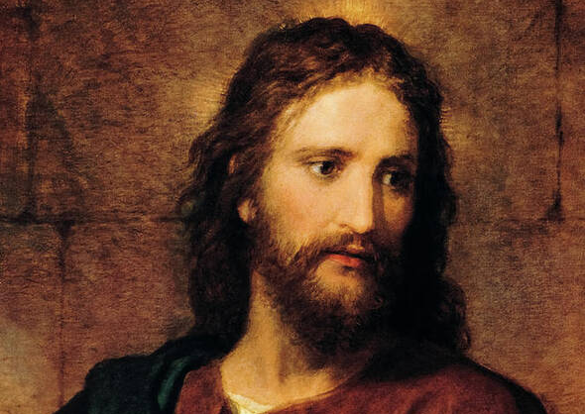
Jesus Paid It All

Slide 2
C
I hear the Savior say,
G C
Thy strength indeed is small,
Am F
Child of weakness, watch and pray,
C G C
Find in Me thine all in all

Slide 3
C Am
Jesus paid it all
C G
All to Him I owe
C F
Sin had left a crimson stain
C G C
He washed it white as snow

Slide 4
C
Lord, now indeed I find
G C
Thy pow'r and Thine alone,
Am F
Can change the leper's spots
C G C
And melt the heart of stone

Slide 5
C Am
Jesus paid it all
C G
All to Him I owe
C F
Sin had left a crimson stain
C G C
He washed it white as snow

Slide 6
C
And when, before the throne
G C
I stand in Him complete
Am F
Jesus died my soul to save
C G C
My lips shall still repeat

Slide 7
C Am
Jesus paid it all
C G
All to Him I owe
C F
Sin had left a crimson stain
C G C
He washed it white as snow

Slide 8
C Csus
Oh praise the one who paid my debt
C Csus
And raised this life up from the dead
C F
Oh praise the one who paid my debt
Dm F
And raised this life up from the dead

Slide 9
C Am
Jesus paid it all
C G
All to Him I owe
C F
Sin had left a crimson stain
C G C
He washed it white as snow

